Slide 1
Supervised Learning Capstone
Predicting Temperature Changes in the US
Matthew Kehoe, December 2023

Slide 2
General problem: rising temperatures in the US
In 1970, the average land and ocean temperature was 59.6 degrees Fahrenheit.
In 2015, the average temperature increased to 60.9 degrees Fahrenheit.
Global temperature is projected to warm by about 1.5 degrees by 2050 and 3.6 – 7.2 degrees by 2100.
Source: Berkeley Earth Climate Data [1]

Slide 3
Modeling temperatures through Kaggle dataset
Kaggle dataset: average temperatures in the US between 1750 and 2015.
Data contains four continuous variables for average land temperature, average land and ocean temperature, minimum land temperature, and the maximum land temperature.
All temperature data has uncertainty boundaries.
Dataset: Earth Surface Temperature Data [2]

Slide 4
The Kaggle dataset
Temperatures values are stored in degrees Celsius. For simplicity, I will convert degrees to Fahrenheit.
The dataset has four other input files:
Global Average Land Temperature by Country
Global Average Land Temperature by State
Global Land Temperatures By Major City
Global Land Temperatures By City
I will only analyze the Average Land and Ocean Temperatures.

Slide 5
Supervised Machine Learning Problem
Seven Potential Feature Variables:
Average Land Temperature, Average Land Temperature Uncertainty
Minimum Land Temperature, Minimum Land Temperature Uncertainty
Maximum Land Temperature, Maximum Land Temperature Uncertainty
Average Land and Ocean Temperature Uncertainty
One Target Variable:
Average Land and Ocean Temperature
Supervised ML Problem:
Which feature variables are needed to predict the target variable?

Slide 6
Exploring and Cleaning the dataset

Slide 7
Data Exploration: size of dataset
The shape of the dataset is (3192,9). So, there are 3192 records and 9 columns.
Eight of the nine columns are continuous variables representing land or ocean temperatures and their uncertainties.
The final column is an object storing the datetime of the average, minimum, or maximum temperature or its uncertainty.

Slide 8
Data Cleaning: removing null data
The date column starts from 1750 for the average land temperature and 1850 for all other temperatures.
This results in 1200 null records for six of the continuous temperature columns.
I rejected records before 1850 and made a new dataset from 1850 and onwards. Its shape is (1992,9) and reduces the number of records from 3192 to 1992.

Slide 9
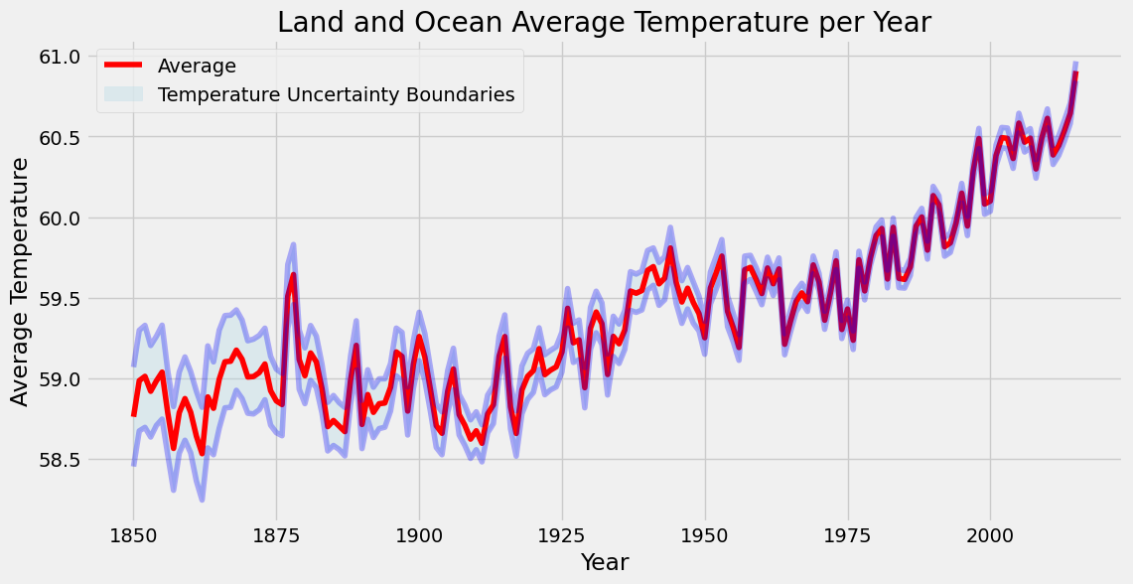
Data Exploration: average temperature past 1850

Slide 10
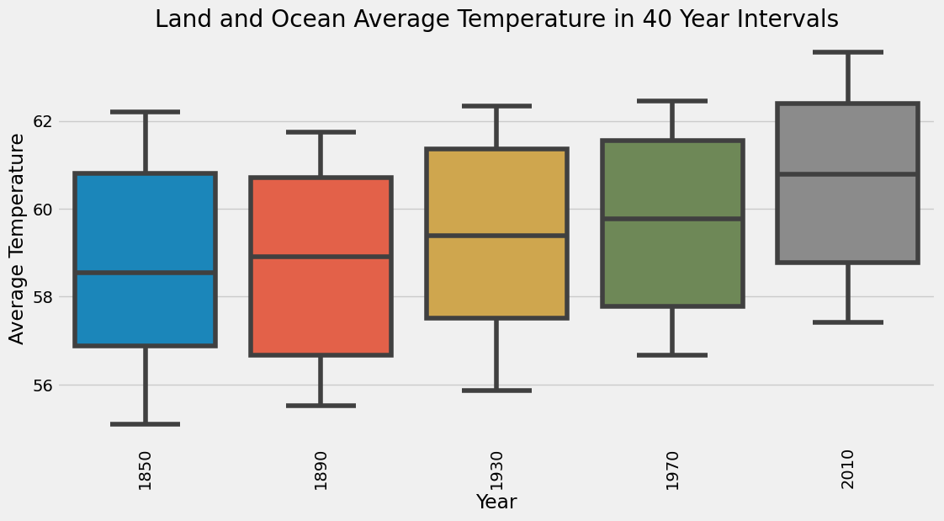
Data Exploration: average temp. in 40 year intervals

Slide 11
Model preparation

Slide 12
Model Preparation: Correlation between columns
My cleaned dataset has the shape of (1992,9) with 1992 records.
I now want to investigate if I need all eight of the feature columns.
To do this, I will use a heatmap to visualize correlations between features.
I will then drop those which aren’t heavily correlated with the target variable (average land and ocean temperature).

Slide 13
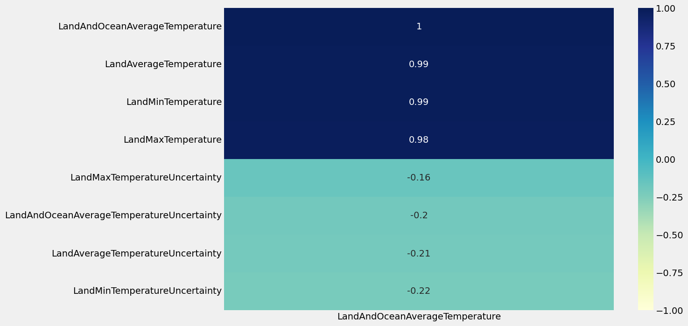
Model Preparation: Heatmap

Slide 14
Model Preparation: features and target
The heatmap shows that the four uncertainty features aren’t highly correlated with the average land and ocean temperature.
Therefore, I will drop them and setup my supervised regression ML problem.
Feature Variables:
Average Land Temperature
Minimum Land Temperature
Maximum Land Temperature
Target Variable:
Average Land and Ocean Temperature

Slide 15
Model Preparation: train and test
I performed a 75/25 split on the dataset with records from 1850 and onwards.
The training set was of size (1494, 3) and had 1494 records for my three features.
The test set was of size (498, 3) and had 498 records for my three features.
All simulations ran within minutes on my laptop and faster on a GPU through Google Colab.

Slide 16
Model Preparation: establishing a baseline
Before I can make and evaluate predictions, I need to establish a baseline, a sensible measure that I hope to beat with my model.
In this case, the average yearly temperature is the baseline. In other words, the baseline is the error I would get if I predicted the average temperature for my target dataset (Y_train).
This evaluated to a Mean Absolute Error (MAE) of 2.03 degrees.
Using machine learning on this problem is only helpful if it can beat the baseline of 2.03 degrees.

Slide 17
Model Selection and Results

Slide 18
Model Selection
A single, continuous target variable with three continuous features sounds like a great case for regression.
A random forest is my first choice, as they handle both regression and classification issues well.
This is a regression problem, so I will also try linear regression.
A gradient boosting regressor is my third option.
The KNN algorithm can look at the k-nearest neighbors for regression.
As a final model, I will try a Support Vector Regressor.

Slide 19
Model Performance
Best performers, ranked:
KNN
Gradient Boosting
Random Forest
Support Vector Regressor
Linear Regression
I built an optimized version the Gradient Boosting Regressor using parameters suggested by GridSearchCV. However, it didn’t beat the KNN Regressor.

Slide 20
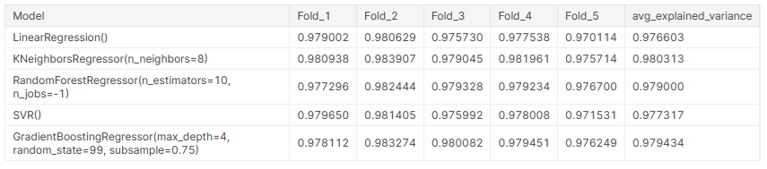
Model Results: average explained variance
I performed cross validation with five folds for all five regression models.
KNN performed the best at explaining the variation of the temperature data.

Slide 21
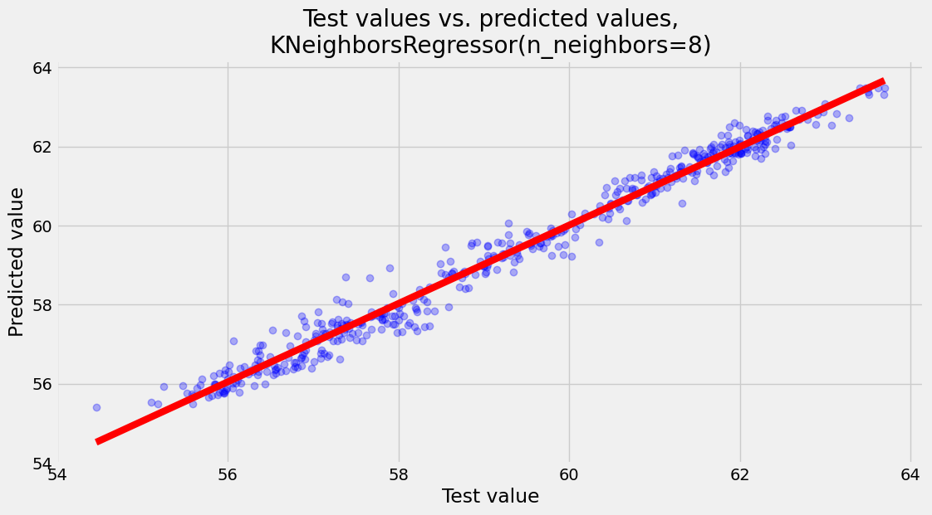
Model Results: test versus predicted values

Slide 22
Model Results: beating the established baseline
MAE of KNN Regressor in the Training Set: 0.21 degrees
MAE of KNN Regressor in the Test Set: 0.24 degrees
MAE of the established baseline: 2.03 degrees
Therefore, it was worthwhile to use machine learning algorithms on this regression problem.

Slide 23
Conclusions and Future Work

Slide 24
Conclusions
In this project, I used historical data from the Berkeley Earth Dataset to predict the Average Land and Surface Temperature using other temperature features.
As my target variable is continuous and I know the target and feature variables, I created a supervised regression machine learning model. I tested several supervised ML algorithms and found that the KNN regressor had the best performance metrics.
My model beat the established baseline of 2.03 degrees and accurately predicted the average temperature.

Slide 25
Real World Applications
My supervised machine learning problem is helpful for predicting average, minimum, or maximum temperature from historical data.
In the real world, I would like to use an existing dataset to predict future temperatures.
This requires forecasting time series data in the future. A well- known machine learning method would be implementing a Convolution Neural Network (CNN).
A good overview of the problem is described in this Medium post [3].

Slide 26
Additional Features for Temperature Forecasting
The National Oceanic and Atmospheric Administration tracks factors impacting temperature and climate [4]. Further analysis can be performed after adding:
Latitude and Elevation
Nearness to center of large landmasses or bodies of water
Location relative to large mountain ranges
Humidity
Ocean Currents

Slide 27
Recommendations for further research
The Berkeley Earth Climate Change study includes separate data for Global Average Land Temperature by Country, Global Average Land Temperature by State, and Global Land Temperatures By City. A separate analysis could be performed on any of these datasets.
As the temperature data is in the form of time series, one could also use a Recurrent Neural Network (RNN) to predict feature temperatures. This would potentially use a GRU or LSTM. A simplified model on a different dataset is shown here [5].
Instead of predicting the average temperature, one could predict the causes of temperature change. This is an active area of research [6] in machine learning.

Slide 28
Notebook Locations
A Jupyter notebook of my work can be found here.
The same notebook is also on Kaggle.

Slide 29
Machine Learning Competitions
Kaggle hosts a variety of machine learning competitions including predicting sales of house prices, natural language processing for disaster tweets, and classifying Arabic letters through images.
I would like to get more involved with the community and participate in competitions.
I am active in two ML Meetup groups and would like to become more active with the machine learning community in Ann Arbor (and elsewhere).

Slide 30
Questions/Discussion

Slide 31
References
Muller, E and Muller, F. Berkeley Earth’s data. Berkeley Earth (Nonprofit), 20 Dec. 2010. https://berkeleyearth.org/data/. Accessed 05 Dec. 2023. [1]
Sissener, K. Climate Change: Earth Surface Temperature Data. Kaggle, 02 Jan. 2017. https://www.kaggle.com/datasets/berkeleyearth/climate-change-earth-surface-temperature-data. Accessed 05 Dec. 2023. [2]
Keith, M. Five Practical Applications of the LSTM Model for Time Series, with Code. Medium, 21 Sep. 2023. https://towardsdatascience.com/five-practical-applications-of-the-lstm-model-for-time-series-with-code-a7aac0aa85c0. Accessed 05 Dec. 2023. [3]
Factors that Affect Climate. Global Monitoring Laboratory - Earth System Research Laboratories. https://gml.noaa.gov/outreach/lesson_plans/ Factors%20that%20Affect%20Climate.pdf. Accessed 05 Dec. 2023. [4]

Slide 32
References (Continued)
Sarkar, T. Weather prediction using Recurrent Neural Network. 10 Jan. 2019. https://github.com/tirthajyoti/Deep-learning-with-Python/blob/master/Notebooks/Weather-RNN.ipynb. Accessed 05 Dec. 2023. [5]
NOAA scientists harness machine learning to advance climate models. GFDL - Geophysical Fluid Dynamics Laboratory, 01 March 2023. https://www.gfdl.noaa.gov/news/noaa-scientists-harness-machine-learning-to-advance-climate-models/. Accessed 05 Dec. 2023. [6]

